Slide 1
Priority system for traffic lights
by Crying in the library

Slide 2
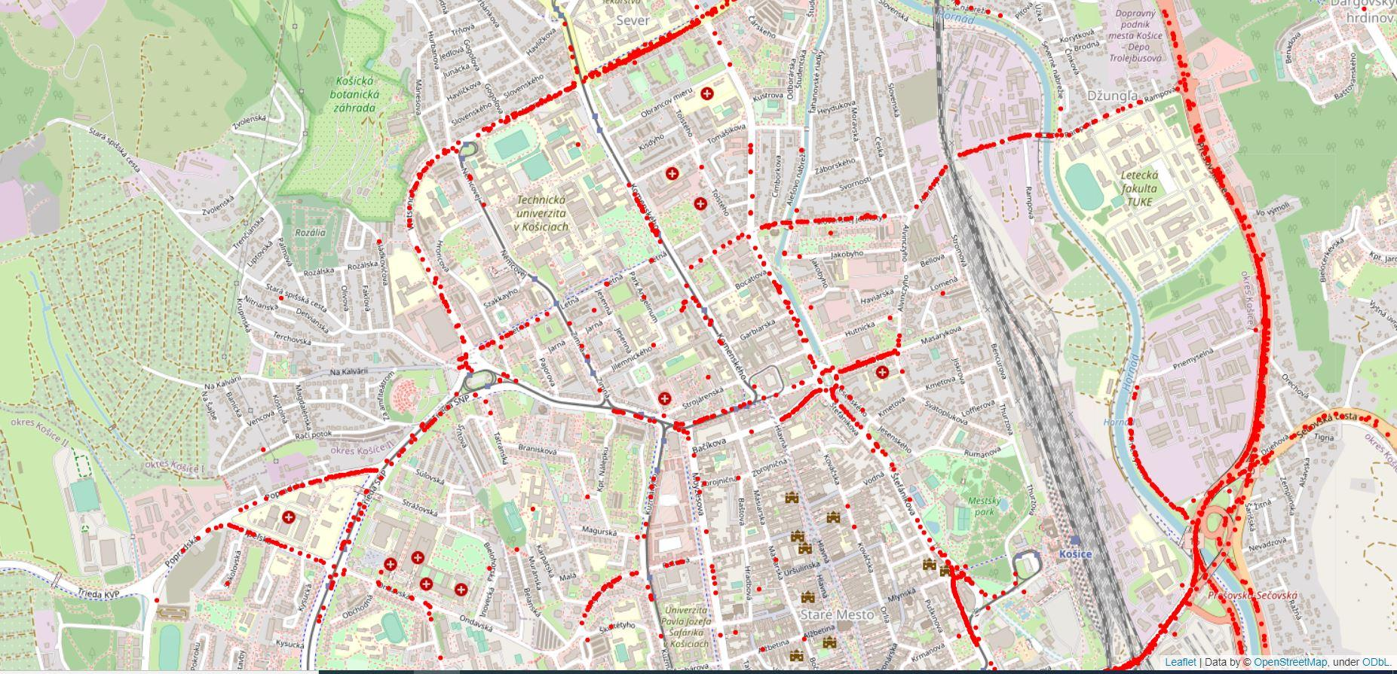
Map of jams

Slide 3
Problem
High Cost and amount of time needed for solving ONE problematic conjunction
Administrative difficulties - Long and tedious process of having plan for ONE conjunction approved
Ineffective current solution
Green light for no one
Multiple traffic lights - short cycles for some lanes, when there is no need

Slide 4
Current solutions
Time Loops
Sensors in the ground (induction loop,pressure sensor,ect.)

Slide 5
Our system
Dynamically change traffic lights, based on priority of groups of cars / time waited
Calculate time necessary to cross conjunction of every car in line

Slide 6
Methodology
Gathered information and data on specific conjunction
Creation of environment for simulation of traffic
Recreating conjunction in simulator with exact cycles of traffic lights
Created our own algorithm for minimizing waiting time
Testing the algorithm effectiveness

Slide 7
Original vs Our system

Slide 8
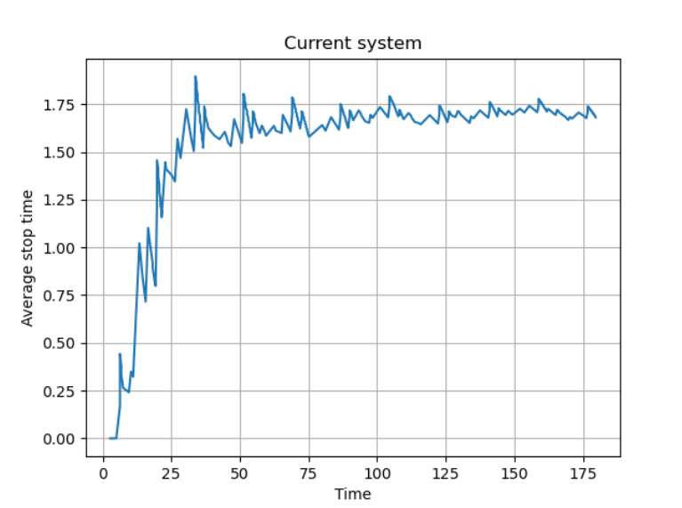
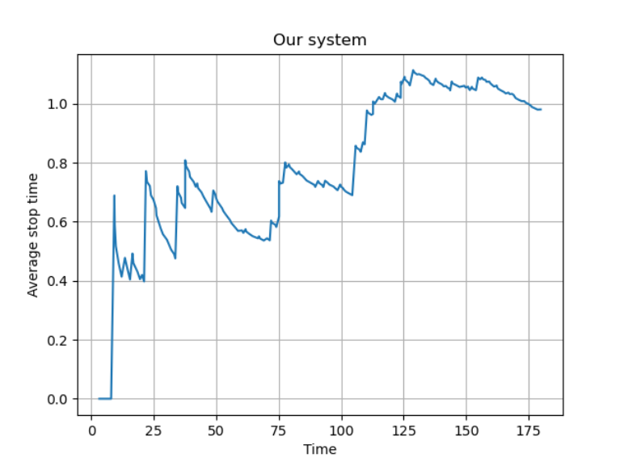
Comparison (Medium traffic)

Slide 9
Potential growth
Effectively optimize transport for entire cities
Adding public transit into the algorithm
Simulating pedestrian crossings

Slide 10
Business potential
Saving cost of fitting conjunctions with purpose-build device (pressure plate ) by using already fitted cameras and providing own cameras cheaply
Complex solution for more efficient and ecological city transportation
Increased safety
Gathering and selling data of traffic for ML/AI

Slide 11
Thank you for your attention

